Slide 1
Lectuer-16 Database Systems and Applications
Ashish Narang

Slide 2
First Semester
2020-21

Slide 3
NoSQL Databases
NoSQL stands for “not only SQL” is an approach to database design that provides flexible schemas for storage and retrieval of data.
These databases have recently become more popular in the era big data.
These databases are preferred for their scalability, performance and ease of use.
The most important result of the rise of NoSQL databases is Polyglot Persistence.

Slide 4
NoSQL What does it mean?
NoSQL was a hashtag(#nosql) chosen for meetup to discuss these new databases.
NoSQL does not have a prescriptive definition but we can make set of common observations, such as:
Not using relational model
Running Well on clusters
Mostly open source
Built for 21st century web estates
Schema-less

Slide 5
Why NoSQL?
To cater to needs of storing and processing huge volumes of data.
Encompasses structured, semi structured and unstructured data.
Enables simpler design, better control over availability and improved scalability.
Have flexible schemas that allow programmers to create and manage modern applications efficiently.

Slide 6
SQL vs NoSQL
SQL
NoSQL
Follows Relational Model
Fixed Schema with structured data
Offers Vertical Scaling
SQL DBs are implemented in both open source(MySQL) and commercial(Oracle) databases
Non Relational
Dynamic schema with unstructured data
Offers Horizontal Scaling
NoSQL is purely open source and MongoDB, BigTable, Redis, Cassandra, Hbase, Neo4j, CouchDB are the main implementations of it.

Slide 7
CAP Theorem
CAP stands for Consistency, Availability and Partition Tolerance.
Consistency means that the data in the database remains consistent after the execution of an operation.
Availability means that the system is always on (service guarantee availability), no downtime.
Partition Tolerance - This means that the system continues to function even the communication among the servers is unreliable.

Slide 8
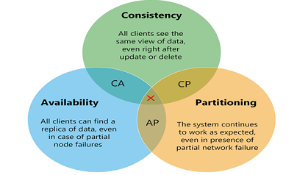
Contd..
CAP theorem states that a distributed database system can only have 2 of the 3: Consistency, Availability and Partition Tolerance.
Source: https://www.researchgate.net/figure/Visualization-of-CAP-theorem_fig2_282679529

Slide 9
BASE
BASE stands for Basically available, Soft state, Eventual consistency.
Basically available indicates that the system does guarantee availability, in terms of the CAP theorem.
Soft state indicates that the state of the system may change over time, even without input.
Eventual consistency indicates that the system will become consistent over time, given that the system doesn't receive input during that time.

Slide 10
Types of NoSQL Databases
NoSQL databases can broadly be categorized in four types
Key-Value Databases
Document Databases
Column Family Stores
Graph Databases

Slide 11
Key Value Databases
In the key-value storage, database stores data in the form of hash table.
The key is usually a simple string of characters and the value is a series of bytes.
The data is usually some primitive data types or more complex object that an application needs to persist and access directly.
Provides more flexibility that allows developers to easily modify fields and object structures.
Popular Key-value databases are Redis and Riak

Slide 12
Document Databases
Stores and retrieves data as a key value pair but the value part is stored as a document which can be XML, JSON and so on.
These documents are self describing, hierarchical tree data structures which can consist of collections and scalar values.
Ability to store varying attributes along with large amounts of data.
MongoDB and Apache CouchDB are popular document based databases.

Slide 13
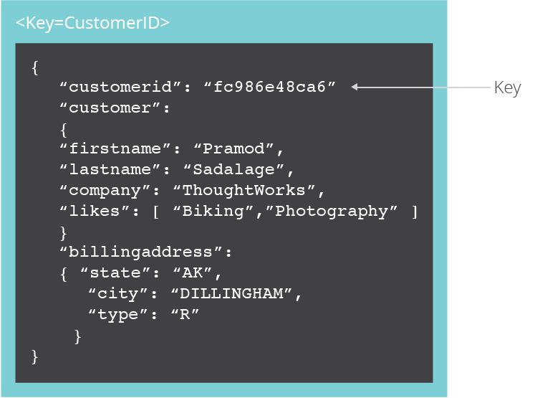
Contd..

Slide 14
Column Based
Column-family databases store data in column families as rows that have many columns associated with row key.
Column families are groups of related data that is often accessed together
They deliver high performance on aggregation queries like SUM, COUNT, AVG, MIN etc.
Widely used to manage data warehouses, business intelligence, CRM.
HBase, Cassandra and Hypertable are examples of column based database.

Slide 15
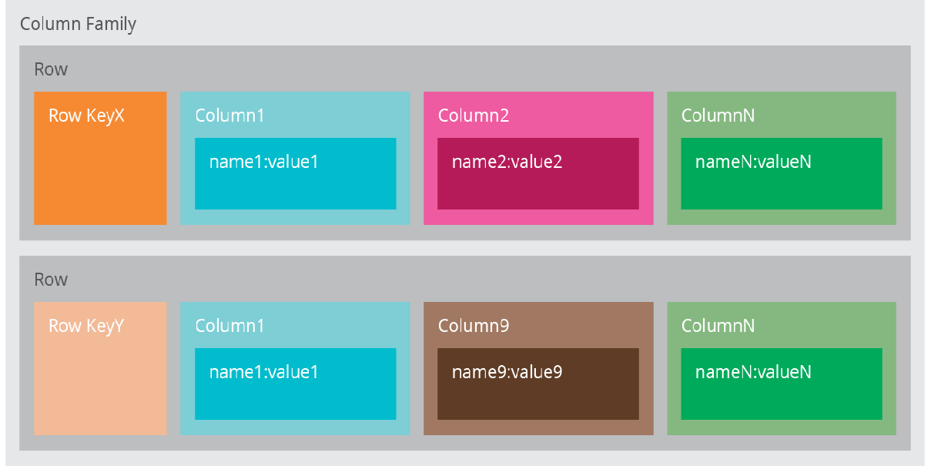
Contd..

Slide 16
Graph Databases
Graph databases allow you to store entities and relationships between these entities.
A graph is a collection of nodes and edges. Each node represents an entity and edges represents relationships.
The organization of data in graphs can be interpreted in different ways based on relationships.
Useful for visualizing, analysing and finding connections between different pieces of data.
Neo4J and Infinite Graph are popular graph based databases

Slide 17
MongoDB
Open source document database.
Written in C++
Indexing on any attribute
Provides high performance, high availability and easily scalable.
Works on the concept of documents and collections
Supports Sharding.

Slide 18
MongoDB- Create Database
The use Command: use to create a new database in MongoDB.
Syntax:
use DATABASE_NAME
Example:
use Employee

Slide 19
MongoDB- DROP Database
The dropDatabase Command: use to create a new database in MongoDB.
Syntax:
db.dropDatabase()
In order to delete a new database
use Employee
db.dropDatabase()

Slide 20
MongoDB- Create Collection
Createcollection() command is used to create a collection in MongoDB
Syntax:
db.createCollection(name,options)
Example
db.createCollection(“mycollection”)
db.createCollection("mycol", { capped : true, autoIndexId : true, size : 6142800, max : 10000 } )

Slide 21
MongoDB- DROP Collection
Db.collection.drop() command is used to drop a collection in MongoDB
Syntax:
db.COLLECTION_NAME.drop()
Example
db.mydb.drop()

Slide 22
Insert Document
db.collection.insertOne() inserts a single document into a collection.
Example:
db.inventory.insertOne(
{ item: "canvas", qty: 100, tags: ["cotton"], size: { h: 28, w: 35.5, uom: "cm" } }
)

Slide 23
Contd..
db.collection.insertMany() can insert multiple documents into a collection. Pass an array of documents to the method.
Example:
db.inventory.insertMany([
{ item: "journal", qty: 25, tags: ["blank", "red"], size: { h: 14, w: 21, uom: "cm" } },
{ item: "mat", qty: 85, tags: ["gray"], size: { h: 27.9, w: 35.5, uom: "cm" } },
{ item: "mousepad", qty: 25, tags: ["gel", "blue"], size: { h: 19, w: 22.85, uom: "cm" } }
])

Slide 24
Query Documents
Db.collectionname.find() is used to retrieve the documents from a collection
To select all documents in the collection, pass an empty document as the query filter parameter to the find method
Example:
db.inventory.find( {} )

Slide 25
Specify Equality Condition
To specify equality conditions, use <field>:<value> expressions in the query filter document
Syntax
db.inventory.find( {<field1>: <value1>,…} )
Example
db.inventory.find( { status: "D" } )

Slide 26
Specifying AND Condition
A compound query can specify conditions for more than one field in the collection’s documents. Implicitly, a logical AND conjunction connects the clauses of a compound query so that the query selects the documents in the collection that match all the conditions.
Example:
db.inventory.find( { status: "A", qty: { $lt: 30 } } )

Slide 27
Specifying OR Condition
Using the $or operator, you can specify a compound query that joins each clause with a logical OR conjunction so that the query selects the documents in the collection that match at least one condition.
Example:
db.inventory.find( { $or: [ { status: "A" }, { qty: { $lt: 30 } } ] } )

Slide 28
Update Documents
MongoDB provides update and set clauses to update the documents with in a collection
Syntax:
db.collection.updateOne(<filter>, <update>, <options>)
db.collection.updateMany(<filter>, <update>, <options>)
Example
db.inventory.updateOne(
{ item: "paper" },
{
$set: { "size.uom": "cm", status: "P" },
$currentDate: { lastModified: true }
}
)

Slide 29
Contd..
Update Multiple Documents:
db.inventory.updateMany(
{ "qty": { $lt: 50 } },
{
$set: { "size.uom": "in", status: "P" },
$currentDate: { lastModified: true }
}
)

Slide 30
Delete documents
MongoDB uses following methods to delete documents from a collection
db.collection.deleteMany()
db.collection.deleteOne()
To delete all documents from a collection, pass an empty filter document {} to the db.collection.deleteMany() method.
db.inventory.deleteMany({})

Slide 31
Contd..
You can specify criteria, or filters, that identify the documents to delete. The filters use the same syntax as read operations.
A query filter document can use the query operators to specify conditions in the following form:
db.inventory.deleteMany({ status : "A" })

Slide 32
References
https://www.thoughtworks.com/insights/blog/nosql-databases-overview
https://docs.mongodb.com/

